Slide 1
Every Man A Warrior
Oct 2026

Slide 2
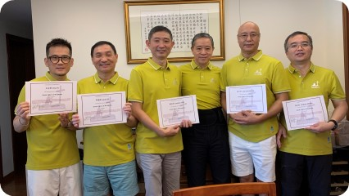
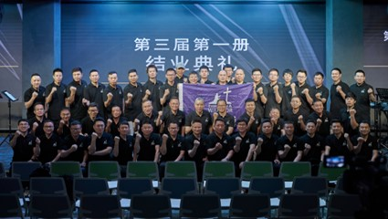
The Ways to Promote
Individual
Churches
Leading Groups
Promoting to Churches

Slide 3
Each Lesson
  Weekly Remind
Push-up
Weekly task remind at least twice
Pushups for every wrong reciting verse
01
02
03
04
Daily Check
Weekly Align
Daily reviewing Verses submitted in Wechat group
Catch up time after lesson
Carl
David
Frank
Allen
Bob

Slide 4
Each Course
1
2
3
4
Leader Training
Leader Gathering
Book 1 Graduation - Walk with God
Leader Excursion
Train the New Leaders
Train the leaders of the New Leaders
training highlights, find what are not doing well, encouraging
up to 4 groups, Sharing, Verse Reciting, Pastor Sharing
team build,
training highlights
7
6
5
Book 3 Graduation - Course Graduation
Leader Refreshing
Book 2 Graduation –
Family Day
Graduation Ceremony (certificate, sharing)
Call for new leaders
Call for new warriors
Call for new churches
team build, pastor sharing, encouraging
1-3 groups, Verse Reciting, Wife/Children Sharing, Brother Sharing, Pastor Sharing
Notes:
5d2d6480-6b0e-4747-beae-361439731ad7.source.7.zh-Hans

Slide 5
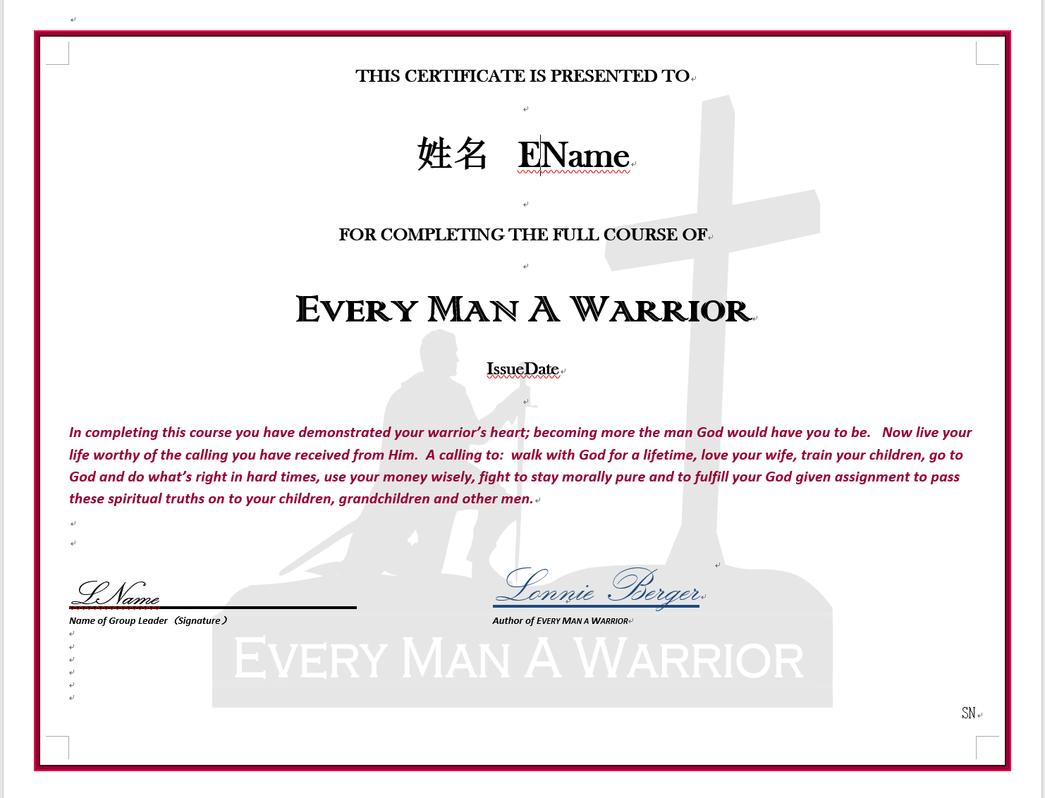
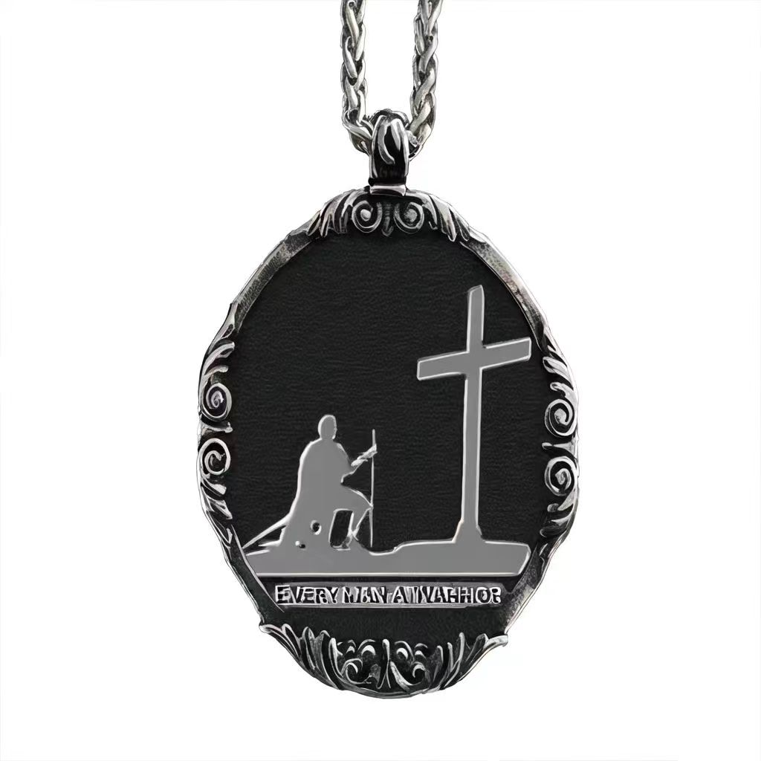
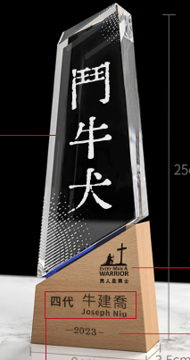
Each Man – 3 Processes
1
Learn
（Certificate）
Lead
(Necklace)
2
3
Lead the Leaders
(Bulldog Award)
Notes:
593f586b-a64e-4aaf-8e87-bc5e4bae58ca.source.3.zh-Hans

Slide 6
Leading - More Focus On Leaders
Group
Call for leaders
Present EMAW necklace
Train the leaders how to lead
Accompany by Companion
Partner a group member as co-leader
Companion: Leader’s leader
Assist in Setting up New Group
Train the leader
Support/Backup leader

Slide 7
Each Church（3 Stages）
03
01
02
Continuous Support
Help church discipling
internally & externally
Lead
a seed group
or
2-3 seed warriors
for a church
Notes:
Help man
Help church
From leaders
Internal discipleship
Train warriors for other churches

Slide 8
Each City
Find Leaders of Churches
Setup the promotion group for the city
Start from church(es)

Slide 9
Materials & Tools
Weekly reminder template
Graduation ceremony templates
Book content review
Leader’s training
Keys to group success

Slide 10
Every Man A Warrior
Commit to Learn！
Commit to Live！
Commit to Lead！
Helping Men Succeed in Life
Building Men So the Church Can Grow
Spiritual Multiplication!!!

Slide 11
Praising GOD
‪Isaiah‬26:12 NIV
Lord, you establish peace for us;
all that we have accomplished you have done for us.

